Slide 1

Analyzing Factors Driving Movie Success
Morgyn Joubert, Sean McLean College of Professional Studies, Northeastern University ALY6015: Intermediate Analytics Prof. Thomas Goulding

Slide 2
Introduction
This project aims to find the key factors influencing movies' success. We use descriptive analysis, correlation assessment, and predictive modeling to achieve our goals. We mainly concentrate on solving the following questions:
Is there a correlation between the user interactions and the movie features in the dataset that would be crucial for recommendation to a user?
Is there a significant correlation between a movie's budget and its popularity, and can this relationship be used to make informed predictions or recommendations for movie budgeting strategies?

Slide 3
2. Movie Budget vs. Popularity: Pearson Correlation Coefficient and Regression Analysis
The Pearson correlation coefficient (r) of 0.505 indicates a moderate positive relationship and suggests that as movie budgets increase, so does its popularity.
This association is further supported by the regression analysis. The coefficient (β) of 0.00000039488 means that as the budget increases by 1 unit, the popularity typically increases by 0.00000039488 units.
Additionally, its p-value (p < 0.0000000000000002) is statistically significant as it is lower than our α = 0.05, which supports the finding.

Slide 4
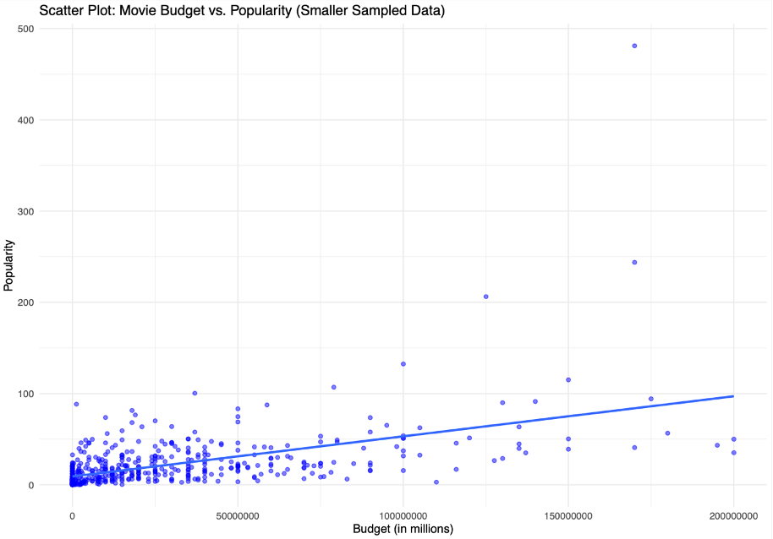
2. Movie Budget vs. Popularity: Scatter Plot Visualization
The scatter plot visually represents the relationship between movie budget and popularity.
Each dot on the plot represents a movie, with the x-axis denoting the budget (in millions) and the y-axis representing the popularity score.
A clear positive trend is observed: as movie budgets increase, popularity tends to rise accordingly.
The trend line on the plot confirms this relationship, showing how changes in budget are associated with changes in popularity.
These insights can help filmmakers make informed decisions about where to invest their resources for maximum impact in attracting viewers.

Slide 5
Methods For Investigation
Descriptive Analysis, Relationship Assessment, and Predictive Modeling.
Linear regression and variance analysis
R Utilization

Slide 6
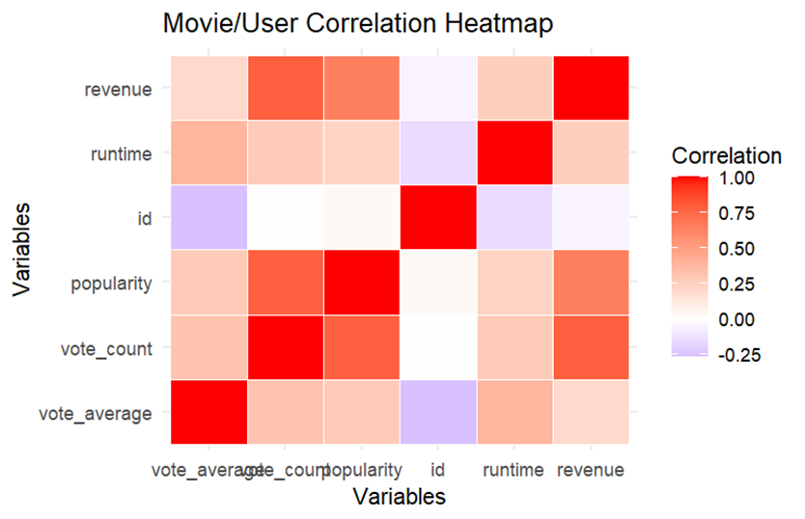
Analyzing Movie-User Dynamics: Uncovering Correlations in Features and Interactions
Correlation Matrix highlights strong relationships among the selected variables.
Linear Regression Modeling for the Vote Counts variable.

Slide 7

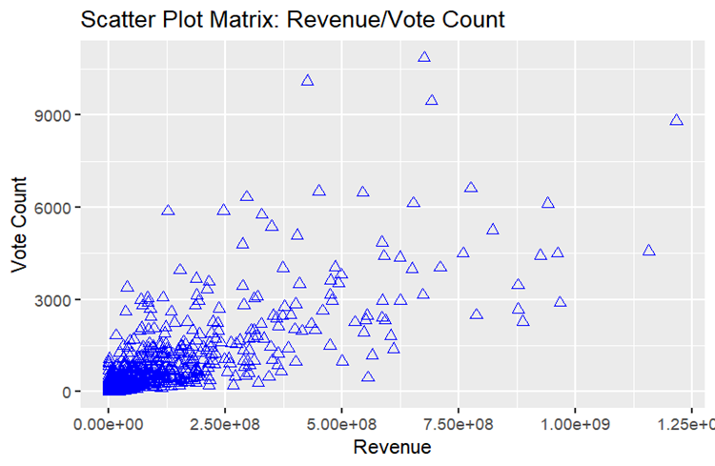
Analyzing Movie-User Dynamics: Uncovering Correlations in Features and Interactions
Visualization of Relationships
ANOVA Testing for Release Dates

Slide 8

Conclusion
Budget Impact on Revenue
Positive Correlations in Movie and User Relationships
Insights for Industry Stakeholders

Slide 9
References
Bluman, A. (2018). Elementary statistics: A step by step approach (10th ed.). McGraw Hill. Kabacoff, R. I. (2022).
R in action: Data analysis and graphics with R and tidyverse (3rd ed.). Manning Publications.
Northeastern University – Canvas – (Panopto) videos by Prof. Thomas Goulding

